Slide 1
DETECTION OF DIABETIC RETINOPATHY FROM RETINAL IMAGING

Slide 2
CONTENTS :
Objective
Abstract
Introduction
Literature Survey
Existing Work
Proposed Work
Software & Required system Configuration Used and Application
Reference

Slide 3
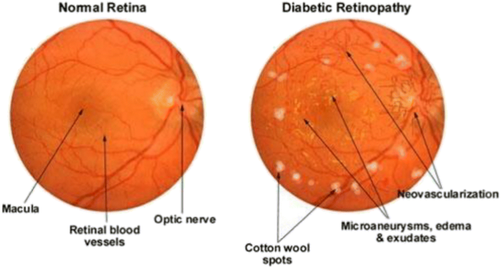
OBJECTIVE :
To develop a system for detecting diabetic retinopathy from the retinal image with wide range of classification and high accuracy.

Slide 4
ABSTRACT :
Diabetic Retinopathy is the most common cause of vision loss among people with diabetes and the leading cause of vision impairment and blindness among working-age adults.
By using a certain algorithm the retinal image from the user is fed into system.
The blood vessels are extracted from the image then it is pre-processed by filtering and segmentation process.
It is followed by fractional edge reduction which is used for the feature extraction and by using a Faster retinal convolutional neural network algorithm to automate the diagnosis process.
It improves the resultant accuracy and by this classification technique we can achieve high accuracy.

Slide 5
INTRODUCTION :
These days, more number of individuals are affected by diabetes which leads to diabetic retinopathy.
Diabetes mellitus, commonly known as diabetes, is a lifelong disease and is a group of metabolic disorder characterized by high levels of sugar in blood.
Diabetes is caused either due to pancreas not producing enough insulin or the cells of the body not responding properly to the insulin produced.
Among 23 million Americans, 59 million Europeans and as many as 50 million Indians suffering from diabetes.

Slide 6
Diabetic retinopathy is a diabetes complication that can cause vision loss and blindness in people who have diabetes.
It causes damage to the blood vessels of the light-sensitive tissue at the back of the retina.
From 2000 to 2010, the number of cases of diabetic retinopathy increased 89 percent from 4.06 million to 7.69 million worldwide.
The Union Health Ministry's first National Diabetes and Diabetic Retinopathy Survey (2015-19) has revealed that the prevalence of Diabetic Retinopathy (DR) is 16.9 per cent while the prevalence of sight-threatening DR is 3.6 per cent.

Slide 7
LITERATURE SURVEY:
REFERENCE | SURVEY | Pros | DRAWBACKS
Diabetic Retinopathy Detection Using Prognosis of Microaneurysm and Early Diagnosis System for Non-Proliferative Diabetic Retinopathy Based on Deep learning Algorithms(2020) | The detection of retinopathy is based on the analysis of microaneurysms. Semantic Segmentation is used to divide image pixels. Convolution Neural Network algorithm is used. | High Accuracy | Retinopathy is detected only based on the analysis of micro aneurysms features.
A weakly supervised framework for interpretable diabetic retinopathy detection on retinal Images(2020) | Multiple instance learning(MIL) framework is used. This proposed technique is the joint optimization of the instance encoding and the image classification stages. | Offline Mode Enabled | It can obtain only the mid-level representation of pathological images.

Slide 8
A method for the detection and classification of diabetic retinopathy using structural predictors of bright lesions(2019) | Gabor filter is applied to the gray scale image for lesion enhancement. A features set is selected for each candidate lesion using a combination of statistical and geometric features. | 4 stages of disease Detected | In pre processing, Gabor filter is used which takes more time for performing features due to its dimension of feature vector is very long.
Automated diabetic retinopathy detection using optical coherence tomography angiography: a pilot study (2020) | OCTA is increasingly used to evaluate diabetic retinopathy. The purpose of this study was designed by computer aided diagnosis(CAD). Combining the system with OCTA data is a plausible next step that would likely improve its robustness. | Tomography Process Discussed | Only adults with type II diabetes mellitus (DMII) were eligible and OCTA scans of the macula were taken, and the five vascular maps generated per eye were analyzed by a novel CAD system.

Slide 9
Deep image mining for diabetic retinopathy screening(2020) | The proposed solution is a promising image mining tool which discover new biomarkers in images. DR screening, severity grade were grouped into Non-referable DR and Referable DR. | Low Quality Image Supported | It creates heat maps showing which pixels in images play a role in the image-level predictions and a ConvNet is used for image-level classification.
Automatic Microaneurysm Detection Using the Sparse Principal Component Analysis-Based Unsupervised Classification Method(2019) | Generally, MA candidates are first identified and machine-learning methods are applied for candidate classification. The proposed solution in this paper, was a novel unsupervised classification method based on sparse posterior cerebral artery (PCA) for MA detection. | Unsupervised Classification | In this proposed system only microaneurysm (MA)is being detected.

Slide 10
Zoom-in-net: Deep mining lesions for diabetic retinopathy detection(2019) | A convolution neural network based algorithm for diagnosing DR and highlighting suspicious regions. A network termed zoom-in-net which mimics the zoom-in process of a clinician to examine the retinal image. | Deep Learning Support Provided | In this proposed system, only the image-level supervision could be done.
Early detection of diabetic retinopathy(2019) | This proposed technique uses retinal structural test, retinal functional test and molecular biomarker. OCT angiography is used in retinal structural test. In molecular biomarker, the bio marks of blood vessels and tissues is compared with the previous test results. | Web App Implementation Available | Several tests are taken to diagnose a single factor of diabetic retinopathy which may involve high time consistency.

Slide 11
Detection of Diabetic Retinopathy using Machine Learning(2021) | we try and summarize the various models and techniques used along with methodologies used by them and analyze the accuracies and results. | More Accuracy supported | It will give us exactness of which algorithm will be appropriate and more accurate for prediction
Diabetic Retinopathy Classification from Retinal Images using Machine Learning Approach(2021) | aim is to develop a system that will be able to identify patients with Diabetic Retinopathy from retinal colour fundus images. | Multiple stages can be predicted | Classification is performed using Random Forest classifier. It classifies five classes of Diabetic Retinopathy.

Slide 12
Classifying Diabetic Retinopathy using Deep Learning Architecture(2020) | A proposed deep learning approach such as Deep Convolutional Neural Network(DCNN) gives high accuracy in classification of these diseases through spatial analysis. | Deep Learning Algorithm gives more Accuracy | .A DCNN is more complex architecture inferred more from human visual perspects. Amongst other supervised algorithms involved, proposed solution is to find a better and optimized way to classifying the fundus image with little pre-processing techniques.
Diabetic Retinopathy Detection using Ensemble Machine Learning (2021) | The proposed framework achieved the highest accuracy rates among all other common classification algorithms in the area. 4 subdatasets were generated to contain the top 5 and top 10 features of the Messidor dataset, selected by InfoGainEval. | Upto 10 Disease Features Considered | accuracies of 70.7% and 75.1% were achieved on the InfoGainEval. top 5 and original dataset respectively. The results imply the impressive performance of the subdataset, which significantly conduces to a less complex classification process when compared to the original complete Messidor dataset.

Slide 13
EXISTING WORK:
The existing system analysis the presence of microaneurysm in fundus image.
Semantic segmentation divides the image pixels based on their common semantic to identify the feature of microaneurysm.
Using convolutional neural network algorithms that embeds deep learning as a core component accelerated with GPU which will perform medical image detection.

Slide 14
PROBLEM STATEMENT
The primary issue is the grading of the retinal images by ophthalmologists (retinal specialists) or trained persons, whose numbers are very scarce compared to the load of patients requiring screening.
Second, some of these patients are based in rural areas and can’t visit an eye care provider.
Thirdly, as such follow ups are required for years together, the attitude, and/or behavioral aspects negatively impact the patients practice despite knowledge of consequences.
These issues can be solved with provision of an automated imaging system within easy reach of the patient.

Slide 15
PROPOSED WORK:
The input retina image is collected from the user and fed to the system.
Image pre-processing steps are applied.
Feature extraction and feature selection is done to examine for further process.
Faster retinal convolutional neural network algorithm is used to classify the level of retinopathy.

Slide 16
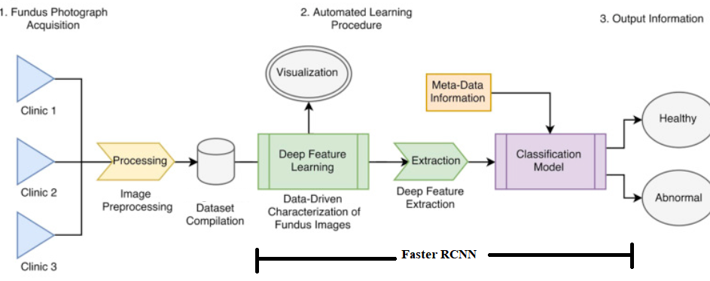
PROPOSED BLOCKDIAGRAM :

Slide 17
Preprocessing Module
Preprocessing Before extracting iris features, the iris image is preprocessed to localize the pupillary (inner) and limbic (outer) boundaries.
Subsequently, the localized iris is transformed to a rectangular template of constant size to cope up with the Retinal under varying illumination conditions.
This is done using Daugman's Rubber Sheet Model.

Slide 18
Normalization Module
The normalized strip corresponding to each Retina is first enhanced to ensure extraction of more discriminative features.
In this project, the enhancement of iris strip comprises of formation of uniformly illuminated Retinal image and contrast enhancement.
To consider the effect of non-uniform illumination, the image is subdivided into blocks and mean of each block will act as coarse estimation of illumination for that block.

Slide 19
Feature Extraction Module
Feature extraction using XOR-SUM Code In this technique, feature extraction is achieved through following steps:
Haar wavelet decomposition x 2D Gabor filtering x XOR-SUM Code

Slide 20
Matching & Classification Module
Retinal scans target the capillary prototype in the retina but it requires a secure physical contact with a scanning device.
Retinopathy does not need such secure physical contact but Retinopathy systems are expensive and need a large amount of computer storage.

Slide 21
REQUIRED SYSTEM CONFIGURATION :
SOFTWARE USED :
Tools : Anaconda IDE
JAVA version : JDK7
i5 PROCESSOR and Above
OS : WINDOWS 7 and Above
Eye clinics
Hospitals
APPLICATION:

Slide 22
CONCLUSION:
The fast and efficient early detection of Diabetic Retinopathy is only possible if there is an effective method for segmenting the diabetic features in the fundus image.
The proposed system presents a fast, effective and robust way of detecting diabetic features in the fundus images which can be used for classification of the images based on the severity of the disease.
The retinal images are subjected to gray scale conversion, preprocessing and feature extraction steps.
The extracted features are fed to a Fast Regional Neural Network classifier which will classify the images into different severity levels.
Thus this Fast Regional Neural Network technique has given a successful DR screening method which helps to detect the disease in multiple stages.

Slide 23
REFERENCE :
Qiao, L., Zhu, Y., & Zhou, H. Diabetic Retinopathy Detection Using Prognosis of Microaneurysm and Early Diagnosis System for Non-Proliferative Diabetic Retinopathy Based on Deep Learning Algorithms. IEEE Access, 8, 104292-104302.
Costa, P., Galdran, A., Smailagic, A., & Campilho, A. (2018). A weakly supervised framework for interpretable diabetic retinopathy detection on retinal images. IEEE Access, 6, 18747-18758.
Amin, J., Sharif, M., Yasmin, M., Ali, H., & Fernandes, S. L. (2017). A method for the detection and classification of diabetic retinopathy using structural predictors of bright lesions. Journal of Computational Science, 19, 153-164.
Sandhu, H. S., Eladawi, N., Elmogy, M., Keynton, R., Helmy, O., Schaal, S., & El-Baz, A. (2018). Automated diabetic retinopathy detection using optical coherence tomography angiography: a pilot study. British Journal of Ophthalmology, 102(11), 1564-1569.

Slide 24
Quellec, G., Charrière, K., Boudi, Y., Cochener, B., & Lamard, M. (2017). Deep image mining for diabetic retinopathy screening. Medical image analysis, 39, 178-193.
Zhou, W., Wu, C., Chen, D., Yi, Y., & Du, W. (2017). Automatic microaneurysm detection using the sparse principal component analysis-based unsupervised classification method. IEEE Access, 5, 2563-2572.
Wang, Z., Yin, Y., Shi, J., Fang, W., Li, H., & Wang, X. (2017, September). Zoom-in-net: Deep mining lesions for diabetic retinopathy detection. In International Conference on Medical Image Computing and Computer-Assisted Intervention (pp. 267-275). Springer, Cham.
Safi, H., Safi, S., Hafezi-Moghadam, A., & Ahmadieh, H. (2018). Early detection of diabetic retinopathy. Survey of ophthalmology, 63(5), 601-608.

Slide 25
Sri, R. Manjula, M. Raghupathy Reddy, and K. M. M. Rao. "Image Processing for Identifying Different Stages of Diabetic Retinopathy." International Journal on Recent Trends in Engineering & Technology 11.1 (2014): 83.
Soumya Sree, A.Rafega Beham. “BP and SVM based Diagnosis of Diabetic Retinopathy”. International Journal of Innovative Research in Computer and Communication Engineering Vol. 3, Issue 6, June 2015.
Aravind, C., M. Ponnibala, and S. Vijayachitra. "Automatic detection of microaneurysms and Classification of diabetic retinopathy images using SVM technique." IJCA Proceedings on International conference on innovations in intelligent instrumentation, optimization and Electrical sciences ICIIIOES (11). 2013.
J D Labhade, L K Chouthmol. “Diabetic Retinopathy Detection using Random Forest”. International Journal of Modern Trends in Engineering and Research e-ISSN No.:2349-9745, Date: 28-30 April, 2016

Slide 26
THANK YOU

